Slide 1
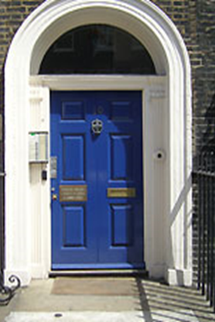

Department of Politics Undergraduate Induction

Slide 2
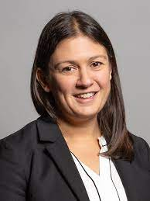
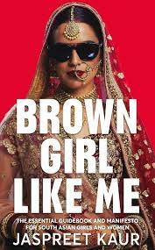
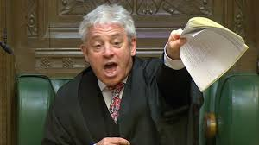

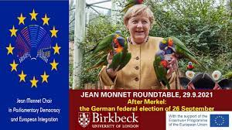
Events

Slide 3


Support
Programme directors, tutors
Series of workshops-exams, essay writing etc
Student union
Disability support
Fellow students

Slide 4
BA Politics Structure (Full time)
 | Term-1 | Term-2 | Term-3
Year-1 | The Study of Politics (30 credits) How the West was Made: Transformations in Global Politics (15 credits) Democracy and Authoritarianism (15 credits) | Comparative Government: Concepts, Methods, and Institutions (15 credits) Political Ideologies and Imaginaries (15 credits) | Comparative Government: Processes (15 credits) Conceptualising Politics (15 credits)
Year-2 | Governing by Numbers (30 credits) Contemporary British Politics (15 credits) Liberalism and its Discontents (15 credits) | Liberalism Order and Disorder in Global Politics (15 credits) Contemporary British Policy (15 credits) Level-5 option (15 credits) | Level-5 option (15 credits)
Year-3 | Doing Political Research (30 credits) Classic Texts (15 credits) | Contemporary Social and Political Theory (15 credits) Level-6 option (15 credits) Level-6 option (15 credits) | Either Level-6 options (30 credits) Or BA Dissertation (30 credits)

Slide 5
BA Politics Structure (Full time)
 | Term-1 | Term-2 | Term-3
Year-1 | The Study of Politics (30 credits) How the West was Made: Transformations in Global Politics (15 credits) Democracy and Authoritarianism (15 credits) | Comparative Government: Concepts, Methods, and Institutions (15 credits) | Comparative Government: Processes (15 credits)
Year-2 | Governing by Numbers (30 credits) Contemporary British Politics (15 credits) | Political Ideologies and Imaginaries (15 credits) Contemporary British Policy (15 credits) | Conceptualising Politics (15 credits)
Year-3 | Liberalism and its Discontents (15 credits) Classic Texts (15 credits) | Liberal Order and Disorder in Global Politics (15 credits) Contemporary Social and Political Theory (15 credits) | Level-5 options (30 credits)
Year-4 | Doing Political Research (30 credits) | Level-6 options (30 credits) | Either Level-6 options (30 credits) Or BA Dissertation (30 credits)

Slide 6
Modules
Each module has a handbook, with detailed description of aims and objectives, learning outcomes, syllabus, and assessment requirements
Most modules will be taught by pre-recorded lecture combined with in-person seminar
Participation in class
Student feedback (class representatives, SSEMs, questionnaires)

Slide 7
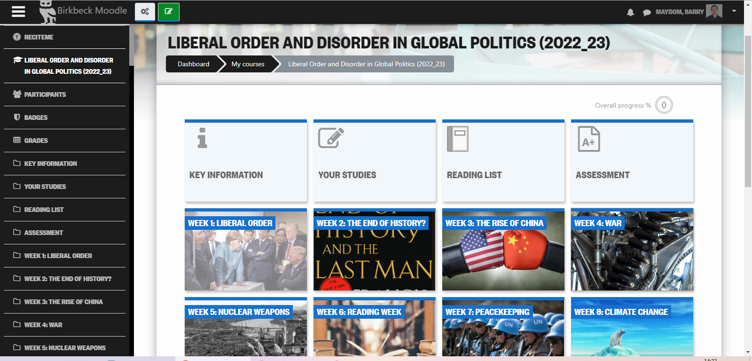
Moodle
Moodle is Birkbeck’s virtual learning platform:
https://moodle.bbk.ac.uk/course/view.php?id=38830
Module and programme pages
Course materials: lectures, reading lists
Assessment submission

Slide 8
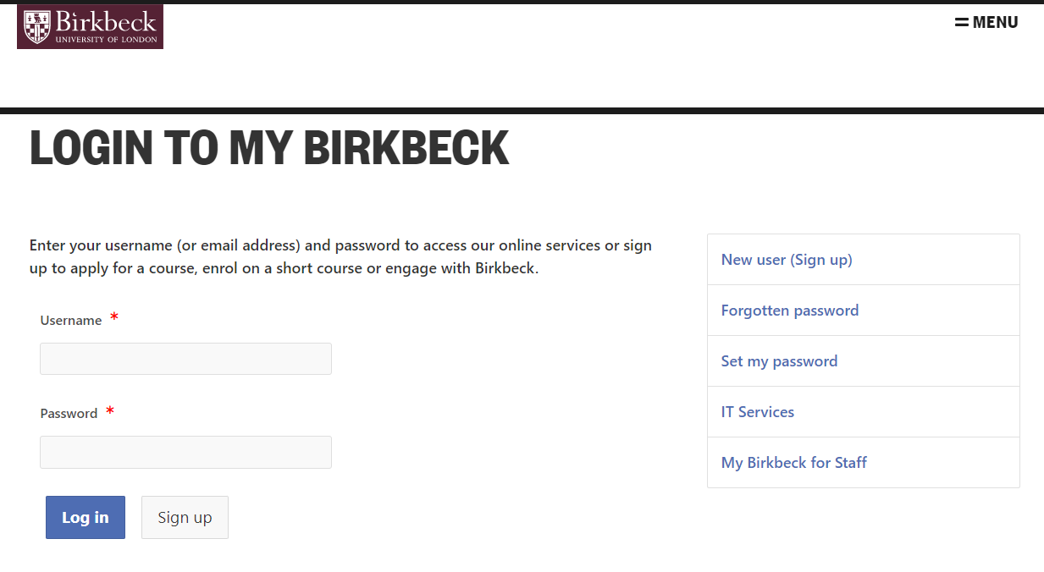
My Birkbeck
Timetables
Support information and sign-up
Administrative matters

Slide 9
Student Services
https://www.youtube.com/watch?v=cvW120Mkl_M&t=186s

